Slide 1

RUNGTA COLLEGE OF DENTAL SCIENCES & RESEARCH
TITLE OF THE TOPIC: COMPLEXAMALGAM RESTORATION
DEPARTMENT OF CONSERVATIVE DENTISTRY AND ENDODONTICS

Slide 2
Specific learning Objectives
At the end of this presentation the learner is expected to know ;
Core areas* | Domain ** | Category #
L OR T SHAPED THREADED PINS | COGNITIVE | MUST NOW
CLASS 3 AND CLASS 4 CAVITY PREPARATION | PSYCHOMOTOR | NICE TO KNOW
CEMENTED PIN PLACEMENT | AFFECTIVE | DESIRE TO KNOW

Slide 3
Table of Content
Mechano anatomical principles for pin placement
Principles for pin placement.
Complication during pin placement
Failure of pin retained restorations
Slot retained amalgam restorations
Amalgam foundations
Chamber retention
Restorative technique
Bonded amalgam
Conclusion
References

Slide 4
L OR T SHAPED THREADED PINS:
Mattos (1973) introduced these pins to overcome the need for bending pins after placement.
suited for class IV preparations as it devoid the need for a second pin at the incisal third.
Advantages:
1. Offer retention without the need for extensive preparation of tooth structure.
2. May increase resistance form of the preparation to some extent.
3. Relatively less time consuming than cast restorations.
4. Comparatively less expensive than cast restorations.

Slide 5
Disadvantages:
Do not increase the compressive strength of the overlying restorative material and
reduce the transverse and tensile strengths significantly.
3. Induce stresses in dentin in the form of cracks or craze lines → increase the potential for fracture of tooth, microleakage, pulpal damage etc.
4. Increase the chances of perforations into the pulp or external tooth surface.
5. Chances of microleakage exist at the pin dentin interface of the verifying restoration leaks.

Slide 6
Cavity Preparations, Designs and Indications for Pin-Retained Restorations
Class II
A. Indications
Class II cavity preparations in shallow and wide cavities where the contemplated axial wall of the preparation will be short or absent completely.
Posterior teeth with missing cusps where retention is not adequate with rest of cavity preparation
Cavity preparation for foundation ,where many forms of possible retention forms will be lost during tooth preparations for future cast restorations.

Slide 7
DESIGN FEATURES:
Pins are auxilliary means of retention that is cavity preparation should have principal means of retention
All surrounding walls ,opposing walls ,boxes and dovetails should be prepared in remaining parts of tooth before placement of pins is planned
Pins should be put in the apically deepest and most peripheral parts of cavity preparation
choice location for pins- facio – linguo proximal corners of tooth, they should be placed slightly mesial or distal and / or facial or lingual to actual axial angle in order to avoid additional stress in critical location
worst location for a pin - is on a table replacing or capping a cusp, exactly under the tip of the cusp, for it will not be possible to achieve the minimum 2 mm restorative coverage for the pin without the possibility of impinging or involving the pulp horns.

Slide 8
6). An ideal arrangement is to have as many flat planes in the cavity preparation as possible, either surrounding the pin or close to it.
The more the surface area of these flat planes, the less the chance for stress concentration in the dentin around the pins.
7) Reciprocation for the pin retention by another retentive form, i.e., another pin, groove, box, etc., at the other side and opposite to the pin is essential in any design for this kind of restoration.
8). As avoid putting pins in the gingival floor proximally, as it could be an isthmus area.
If the gingival floor is deep apically, although the pin may not encounter the isthmus area, it may encounter the root canal or root concavities at its tooth end.

Slide 9
9)It is a good idea to establish external boxes (proximally, facially and/or lingually) adjacent to a pin, as this will immobilize the restoration, at least laterally, minimizing the stresses on the pin
It does not matter how short the walls of these boxes are, even half a mm will create some immobilization.
10)In locating pins for foundations, consider the future reduction for the cast restoration and estimate the minimum amalgam or composite resin coverage of the pin.
Pins will be placed more axially in teeth receiving future cast preparations, than when the pins will be retaining a final restoration.

Slide 10
11) Try to use the minimum number of pins possible,
12). Analyze and estimate the direction of displacing forces on the contemplated restoration, and try to locate pins at the starting and terminating points of these possible movements
13)Use minimum size of pin possible relative to size of restoration and remaining tooth structure
14)one side of the pin is close to a wall, usually the axial wall, enough space between the pin and this wall should he left (prepared) to accommodate a bulky amount of the restorative material for it to be self-resistant as well as to grip the pin.
Remember, there should be at least 1.5-2 mm of restorative material lateral and occlusal to a pin.

Slide 11
CLASSIII AND CLASS IV CAVITY PREPARATIONS
Indications:
two-thirds or more of the inciso-gingival length of the clinical crown,
the labial, incisal and lingual walls are either completely lost or have no dentin.
the remaining tooth structure cannot accommodate retentive grooves or boxes compatible in bulk to the size of the foundation, without encroaching on vital pulp or root canals.
final restorations in Class III and IV lesions in situations where there is little or no remaining enamel on the tooth
In restoration- which is going to be directly loaded in centric and excursive mandibular movements
6) If the available enamel to be etched cannot be strategically distributed around the defect to warrant adequate resistance and retention for the future restoration.

Slide 12
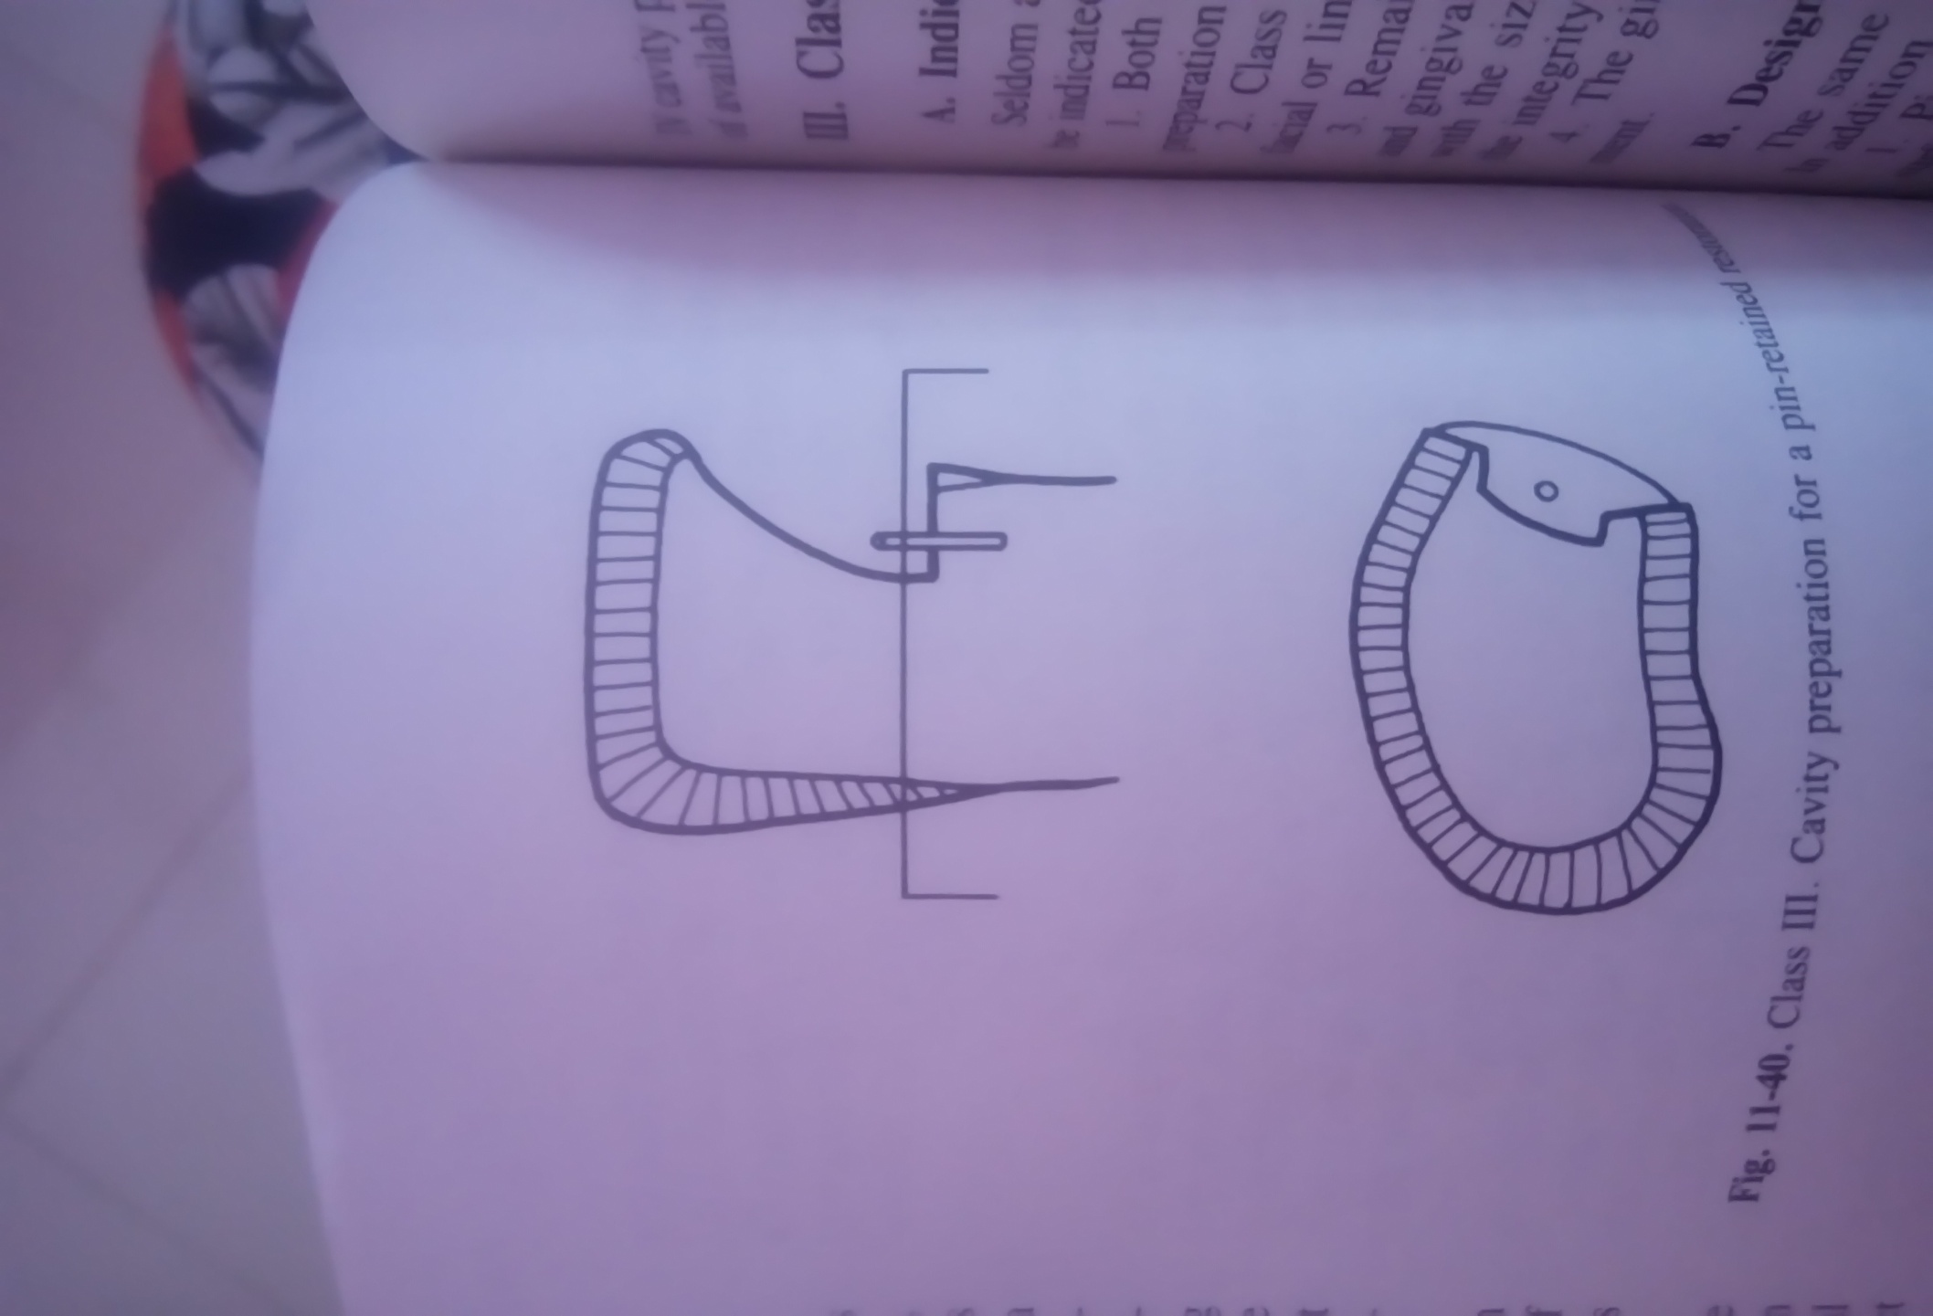
DESIGN FEATURES
1) establish as pronounced a gingival floor in its two dimensions as possible.
2). Create labial and lingual walls even as little as 1 mm long.
Sometimes it is necessary to extend the gingival floor apically, or the axial wall must be deepened to accommodate these walls.
Each wall may not be continuous inciso-gingivally,so there may be incisal and gingival portions separated with an area of no wall labially and lingually.
These walls are very important in immobilizing the future restoration.

Slide 13
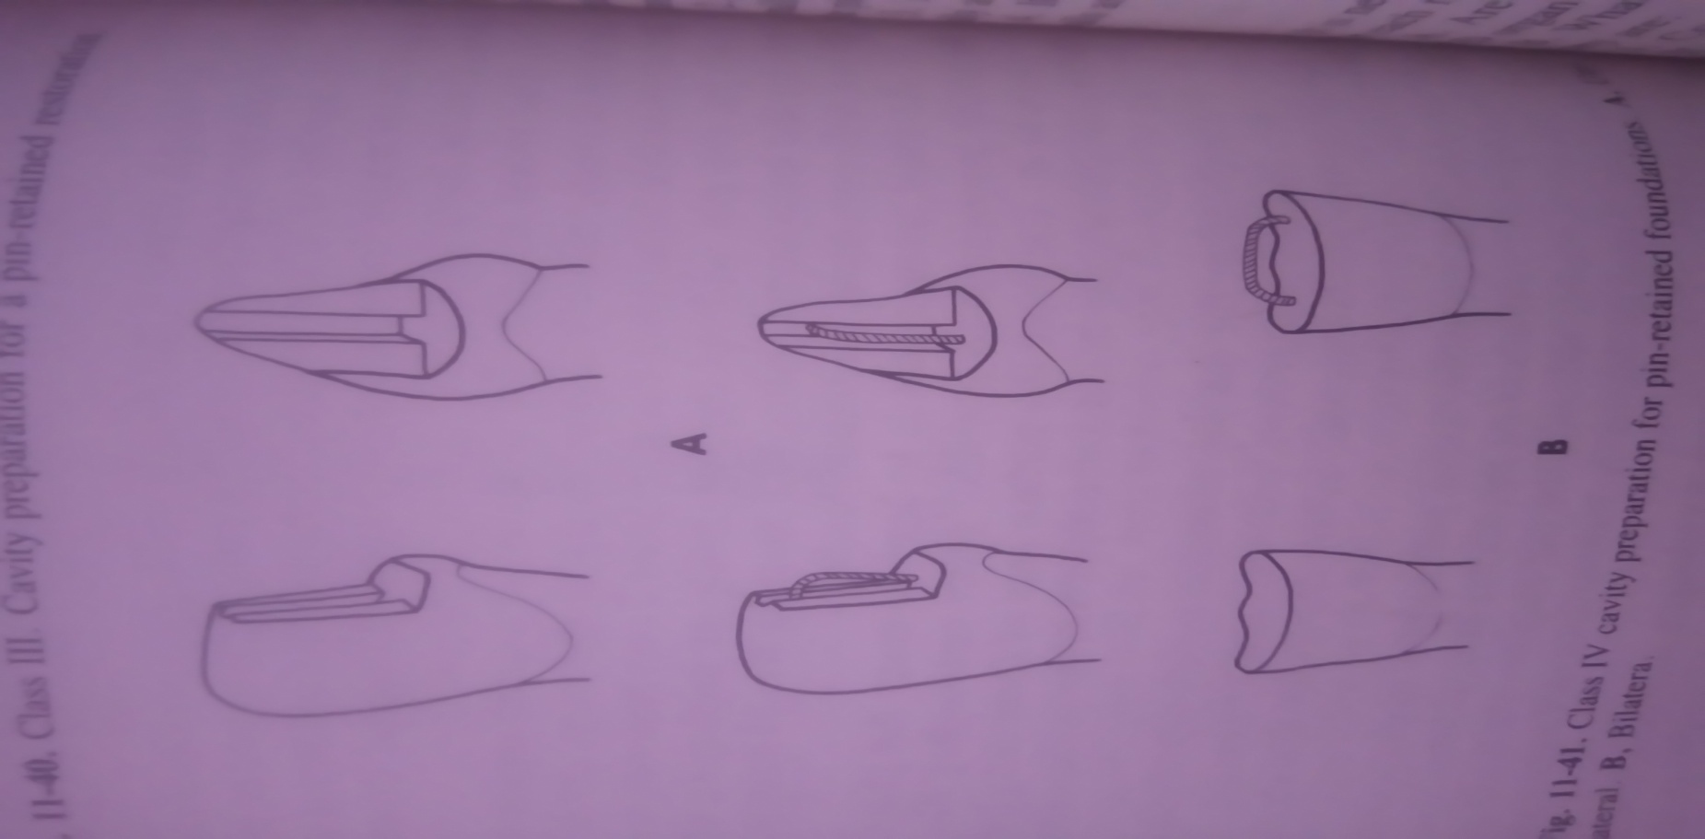
3. If cavity margins approach the incisal angle, try to support it as much as possible by avoiding retention forms there .
4. Placement of only one pin per gingival floor is sufficient
5. For unilateral Class IVs, the L-shaped cemented pin is the most efficient.
It is to be emphasized that the short arm of the L will fit incisally, not in pin channel but with a –"step" which should not exceed 1 mm in depth.
These L-shaped pins are used only when there is sufficient dentin bulk between the labial and lingual enamel plates acommodate them (2 mm and more)
6. for bilateral Class IV , the U shaped cemented pin ( staple) is ideal.
The two ends of U pin will be located gingivally

Slide 14
7. In the L-shaped and the U-shaped cemented pin techniques, sufficient space should be left between the vertical or horizontal arms of the pins and the internal parts of the cavity preparation to accommodate a bulky amount of the restorative material.
8. The bending of the pins in the L- or U-shaped cemented pin technique should be gradual and very rounded to avoid fracture and stress accumulation, and to improve adaptability of the restorative material at these corners.
9. For esthetic purposes, pins should be located as internally as possible, away from direct observation, and covered with an opacifier .
10.Conditioning of available enamel

Slide 15
CLASS V
Indications
1)Both the mesial and distal walls of a Class V cavity preparation are lost.
2). Class V cavity preparations involve half or more of the facial or lingual surface of the tooth.
3). Remaining tooth structure cannot accommodate occlusal and gingival retention grooves large enough to be compatible with the size of the future restoration without compromising the integrity of the pulp, root canals, or furcation areas.
4). The gingival floor is lost due to fracture or furcal involvement.

Slide 16
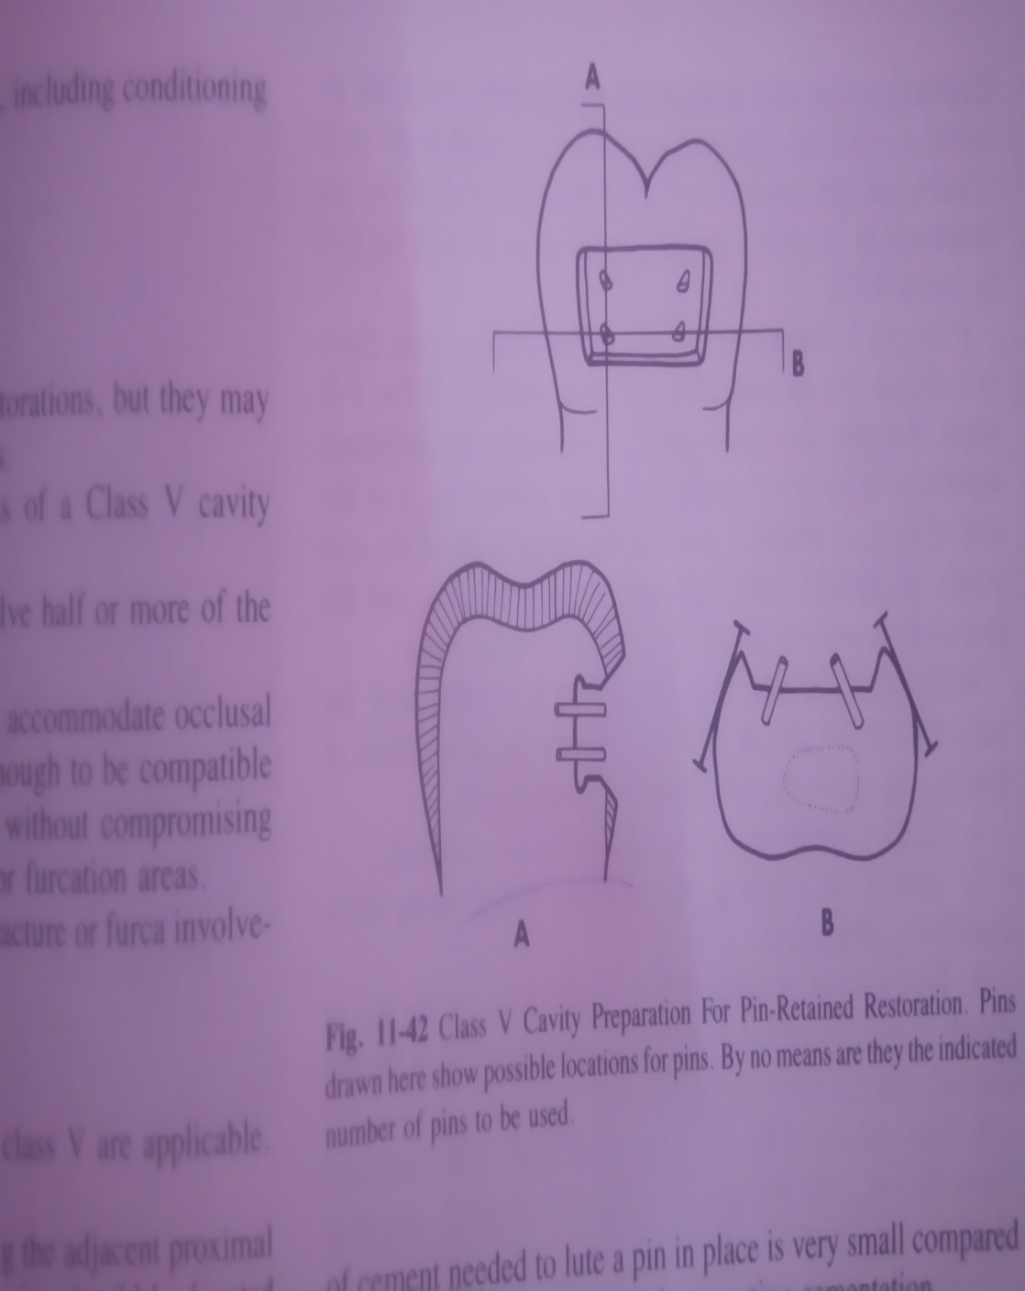
DESIGN FEATURES
1. Pins are placed axially, paralleling the adjacent proximal surface.
In the mesio-distal direction, pins should be located
between the axial angle and the pulp or root canal periphery.
In the inciso- (occluso-) gingival direction, pins should be midway in the preparation, but as close to the gingival wall as possible.
2. Pin protrusion within the cavity should be minimal (maximally 1 mm) to allow for restorative material bulk between the pin and restoration surface
3. Place as many bulky and deep retentive grooves occlusally and/or gingivally as possible.
4. It is essential to have as pronounced occlusal and gingival walls as possible in order to immobilize the future restoration.

Slide 17
Cemented pin Placement
Pin holes extending 4-6 mm into dentin are prepared using twist drills.
The commonly used pin is in the form of stainless steel wires, which are serrated
or threaded and cut to required length using Dial ­A Pin cutter.
The pin is held on the locking tweezer or grooved hemostats and placed on the pinhole for checking its fit and length.
Pin channels are dried with precut endodontic paper point.

Slide 18
The cement mix is introduced into the pin channel with a root canal file or lentulospiral
The pin held in the forceps is also coated with the cement and inserted into the hole.
The pin is held in its position till the cement sets.
The pin is cut and modified by creating a longitudinal facet with a carborandum disc.

Slide 19
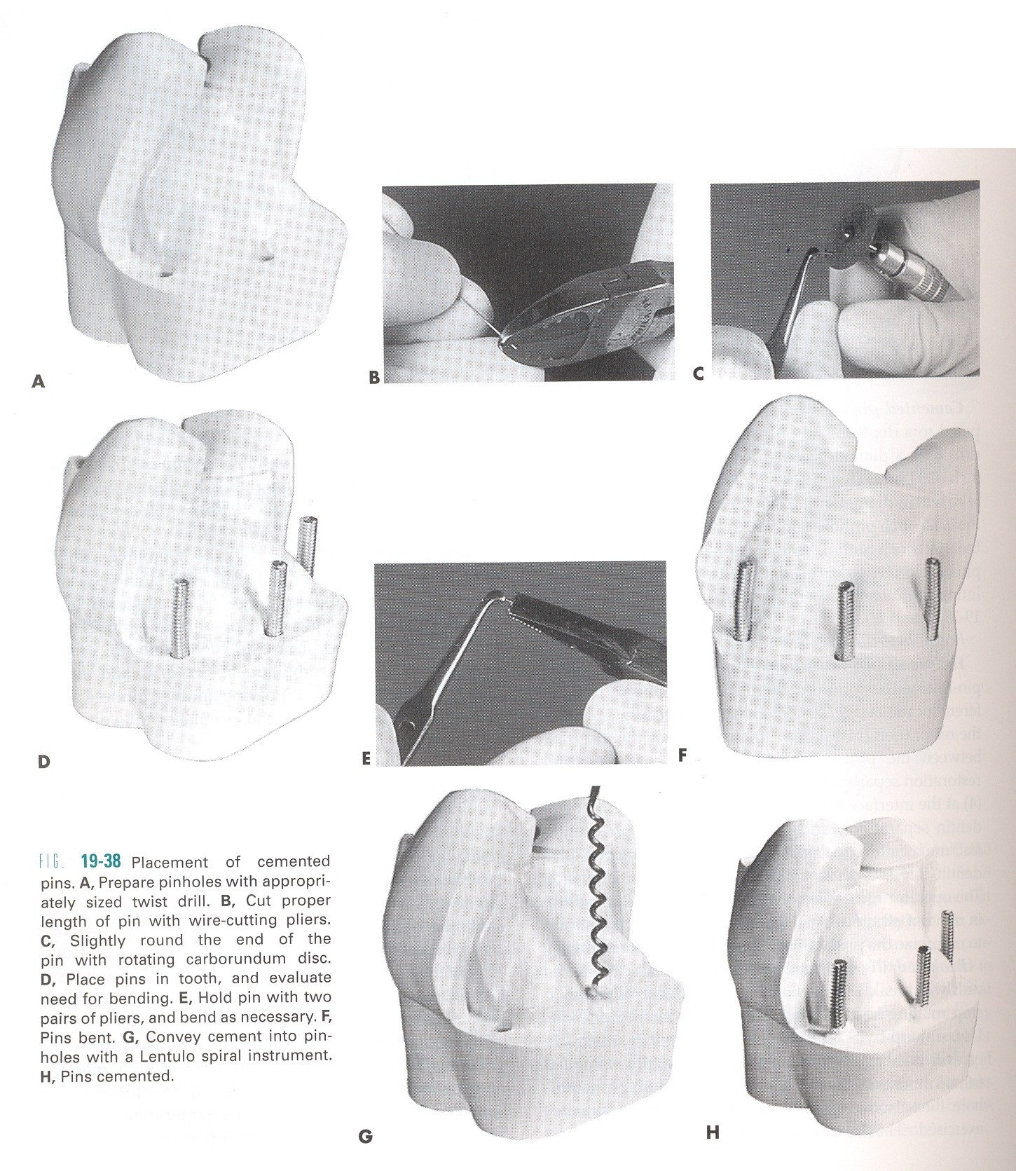

Slide 20
Friction grip technique
A self -centering spiral drill mounted in a low speed hand piece is used to prepare the pin channel in dentin to a depth of 2-3 mm, 1.5mm inside the DEJ. The channel must be kept dry until the pin is inserted.
The friction locked retention pins are smooth surfaced and may be prefabricated from stainless steel wires
The depth to which the pin channel has been drilled is marked on the pin with a permanent marker.
The pin is inserted into a pin setter and carried to the pinhole.
A mallet is used to apply force parallel to the axis of the pin.

Slide 21
Pin Removal:
Occasionally replacement of a pin retained restoration may necessitate removal of pins.
Methods:
Pin can be grasped directly with an artery forceps and unwound.
Bond a tube to the pin with a cyanoacrylate adhesive, which may facilitate unscrewing the pins with forceps especially for those pins, which are short in length.
with a rotating bur that produces anticlockwise rotation in the pin.
with ultrasonic tip.
The vibrating tip is held in contact with the pin and rotated anticlockwise in a unscrewing motion.

Slide 22
Complication during pin placement
1. Broken drills and pins:
• Twist drill will break if :
Stressed laterally
Allowed to stop rotating before
removing from the pinhole.
Dulls (20 holes)
Pin will break
During bending
Over - screwed in the hole
Solution: Leave it in place.
Do another hole 1.5mm from broken item

Slide 23
2Loose pins
• Due to:
Repeated insertion and removal of the pin drill enlarging the pin channel.
- Pin drill is rotated for more than instructed resulting in large sized channels.
- Manufacturer's discrepancy is poor quality control between the pin drill and pin sizes.
- A self shearing pin fails to shear resulting in stripped out dentin.
Solution:
• Remove pin , pinhole prepared with next largest size drill , appropriate pin inserted
• Drill another hole 1.5mm from original pinhole,close the other one with amalgapins or cement the pin

Slide 24
3.Penetration into the pulp and perforation of the external tooth surface:
• Either penetration is obvious if there is hemorrhage in the pinhole
• Radiograph can help sometimes.
External perforation may occur
Over the prominent mesial concavity of maxillary first premolar
At the midlingual & midfacial bifurcations of mandibular first & second molars
At the mid facial, mid mesial & mid distal furcations of maxillary first & second molars

Slide 25
TAKE HOME MESSAGE
Because of its history, the complex amalgam restorations may be the most frequently placed complex restoration.
However due to the increasing benefits of composites, the many types of auxiliary retention forms available, and the variations of tooth preparations required for complex restorations, the operator should be familiar with all of these techniques, if he or she is to use these restorations on a regular basis.

Slide 26
QUESTIONS
WHAT IS RESTORATIVE TECHNIQUE
SLOT RETAINED AMALGAM RESTORATION
PIN RETAINED AMALGAM RESTORATION

Slide 27
REFERENCES:
1. Sturdevant's Art and Science of Operative Dentistry - fourth Edition
2. Operative Dentistry - Modern theory and practice - First Edition- M.A. Marzouk
3. Text book of operative dentistry - Vimal K. Sikri
4.Fundamentals of Operative Dentistry- Summit JB- 2nd edition
5.Text book of operative dentistry → nisha carg,amit carg
6.Principles and Practice of Operative Dentistry-Gerald T. Charbeneau-Third edition.
7.Clinical operative dentistry-principles and practice→ramya Raghu,Raghu sreenivasan

Slide 28
THANK YOU

